Slide 1

ENTERPRISE CYBER DEFENSE / 2026
Creation of Security Operations Dashboard for Threat Detection with Risk Mitigation Analytics
Centralized Cybersecurity Threat Analysis Platform
2026-08-18 | PROFESSIONAL PRESENTATION

Slide 2
02 / THREAT INTELLIGENCE
One interface. Every signal.
A web-based platform that turns fragmented security inputs into explainable, actionable threat intelligence.
01
02
03
04
05
06
URL
IP
QR
IMAGE
UPLOAD
AI COPILOT
BUILT FOR / SECURITY ANALYSTS · SOC TEAMS · RESEARCHERS
Centralize analysis • accelerate triage • explain every score
AEGIS / AI-ASSISTED THREAT DETECTION
02

Slide 3

03 / THREAT INTELLIGENCE
Fragmentation is the threat.
80%
of security analysts report tool overload and inefficient workflows
MULTIPLE INTERFACES / COMPLEX ANALYSIS / SLOW TRIAGE
AEGIS / AI-ASSISTED THREAT DETECTION
03

Slide 4
04 / THREAT INTELLIGENCE
From signal to decision.
A centralized monitoring plane orchestrates every analysis module through one explainable workflow.
01
02
03
04
05
06
07
COLLECT
ANALYZE
SCORE
CLASSIFY
VISUALIZE
RECOMMEND
REPORT
URL · IP · QR · OCR · PEN TEST · FILE INTELLIGENCE
AEGIS / AI-ASSISTED THREAT DETECTION
04

Slide 5
05 / THREAT INTELLIGENCE
Secure access. Personal context.
WELCOME BACK
Welcome Back,
Srilekha
analyst@aegis.security
ADMIN
••••••••••••
Firebase Authentication
Identity-aware interface
Profile & session management
SECURE SIGN IN
AEGIS / AI-ASSISTED THREAT DETECTION
05

Slide 6
06 / THREAT INTELLIGENCE
Your SOC, at a glance.
1,284
73
92%
04
EVENTS
HIGH RISK
COVERAGE
ACTIVE ALERTS
THREAT VOLUME / 24H
THREAT DISTRIBUTION
PHISHING 34%
MALWARE 26%
DDoS 18%
RANSOMWARE 13%
INSIDER 9%
AEGIS / AI-ASSISTED THREAT DETECTION
06

Slide 7
07 / THREAT INTELLIGENCE
Inspect the link before it clicks.
https://secure-account-verify.example-login.co
ANALYZE URL
HTTPS
VALID
78
DOMAIN TRUST
LOW
HIGH RISK / PHISHING
SUSPICIOUS KEYWORDS
3 FOUND
REDIRECT CHAIN
2 HOPS
AEGIS / AI-ASSISTED THREAT DETECTION
07

Slide 8

08 / THREAT INTELLIGENCE
Know every address.
Local classification and heuristic risk scoring reveal what an IP represents—and why it matters.
8.8.8.8
KNOWN DNS / GOOGLE PUBLIC DNS
PUBLIC
PRIVATE
LOOPBACK
MULTICAST
RISK SCORE 08 / 100
AEGIS / AI-ASSISTED THREAT DETECTION
08

Slide 9
09 / THREAT INTELLIGENCE
Decode intent, not just content.
01
02
03
URL
EMAIL
PHONE
STRUCTURAL + KEYWORD ANALYSIS
CONTENT TYPE DETECTION
CONTENT TYPE DETECTION
04
05
06
SMS
WI-FI
PLAIN TEXT
CONTENT TYPE DETECTION
CONTENT TYPE DETECTION
CONTENT TYPE DETECTION
AEGIS / AI-ASSISTED THREAT DETECTION
09

Slide 10
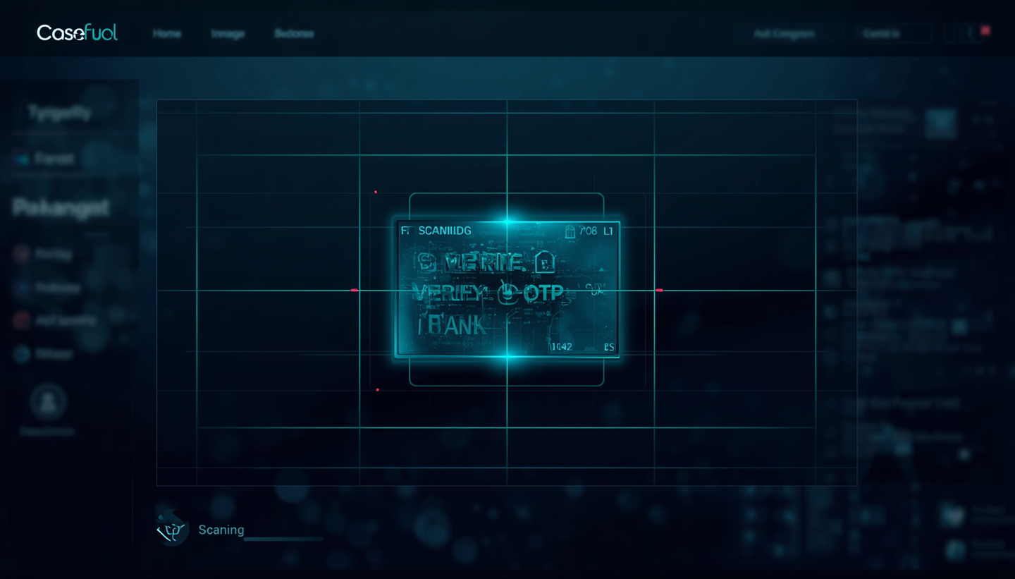
010 / THREAT INTELLIGENCE
See the threat hidden in pixels.
OCR
Upload → extract text → match phishing language → classify risk
VERIFY / OTP / BANK
SAFE · WARNING · HIGH RISK
AEGIS / AI-ASSISTED THREAT DETECTION
10

Slide 11
011 / THREAT INTELLIGENCE
Simulate the exposure. Prioritize the fix.
SIMULATED TEST RESULTS
REAL SYSTEM STATUS
64 / 100
DEMO
OPEN PORTS 04
SSL / TLS WEAK
HEADERS 03 MISSING
EXPOSURE FTP · TELNET
Educational simulation only.
No live exploitation performed.
AEGIS / AI-ASSISTED THREAT DETECTION
11

Slide 12
012 / THREAT INTELLIGENCE
Bring every artifact into view.
Multi-format ingestion creates one analysis surface for diverse security evidence.
CSV
JSON
XLSX
PDF
PAPA PARSE
CUSTOM PARSER
CUSTOM PARSER
CUSTOM PARSER
IMAGE
TXT
LOG
XML
CUSTOM PARSER
CUSTOM PARSER
CUSTOM PARSER
CUSTOM PARSER
AEGIS / AI-ASSISTED THREAT DETECTION
12

Slide 13
013 / THREAT INTELLIGENCE
Ask the dashboard.
An interactive cybersecurity copilot explains threats, concepts, scores, and recommended actions in plain language.
How was this URL scored?
AI
The score increased because the domain has low trust, uses three urgency keywords, and redirects twice before reaching the destination.
What should I do next?
Block the domain, preserve the artifact, and review related user activity before escalating the incident.
AEGIS / AI-ASSISTED THREAT DETECTION
13

Slide 14
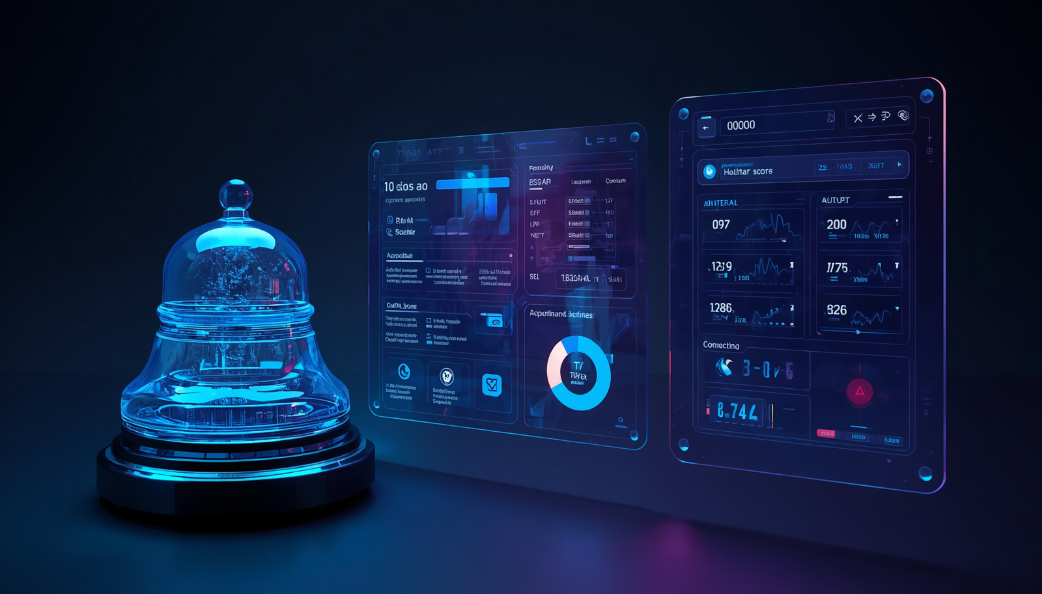
014 / THREAT INTELLIGENCE
Alert. Explain. Act.
04
ACTIVE NOTIFICATIONS
Real-time events feed structured reports with threat score, risk class, evidence, and recommendations.
AEGIS / AI-ASSISTED THREAT DETECTION
14

Slide 15
015 / THREAT INTELLIGENCE
Built for modern delivery.
FRONTEND
React.js · TypeScript · Vite · Tailwind CSS · Recharts
IDENTITY
Firebase Authentication
INTELLIGENCE
VirusTotal API for external URL context
WORKFLOW
Git / GitHub · npm · Visual Studio Code
DEPLOYMENT
Vercel · environment-based API key management
AEGIS / AI-ASSISTED THREAT DETECTION
15

Slide 16
016 / THREAT INTELLIGENCE
Prototype today. Platform tomorrow.
CURRENT LIMITATIONS
PLANNED EVOLUTION
Deterministic heuristics
Rule-based scoring
Simulated modules
No real-time SIEM
No ML anomaly detection
Backend API
Role-based access
Real-time alerts
Advanced threat correlation
Cloud integration
AEGIS / AI-ASSISTED THREAT DETECTION
16

Slide 17
017 / THREAT INTELLIGENCE
Clarity becomes an advantage.
01
ONE SECURITY SURFACE
02
EXPLAINABLE RISK
Centralized multi-input analysis
Clear scoring and recommendations
03
AI-AUGMENTED
04
BUILT TO EVOLVE
Accessible guidance in context
Modular, extensible web architecture
AEGIS / AI-ASSISTED THREAT DETECTION
17

Slide 18
END OF BRIEFING / AEGIS 2026
THANK YOU FOR
YOUR ATTENTION
Questions and Discussion
NEXT STEP / EXPLORE THE LIVE DASHBOARD
AEGIS / AI-ASSISTED THREAT DETECTION
18

